Slide 1
Analysing Neighbourhoods of Manchester for starting an potential Restaurant
Prashant Bhiekhemsing
IBM Applied Data Science
07/09/2021

Slide 2
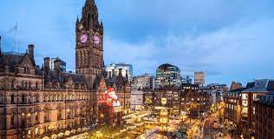
Introduction
- Manchester: One of the biggest cities in UK
UK’s second most populous area, with a population of roughly 3Mio
The population is diversified from ethnicities all over the world

Slide 3
Business Problem
Start a potential restaurant
Finding a neighborhood that is most likely to do well

Slide 4
Data
Neighbourhoods of Manchester
Manchester Wikipedia page. Data scraping is used
Geographical coordinates of the different neighbourhoods
GeoPy Library is used
Venue data from FourSquare
FourSquare API

Slide 5
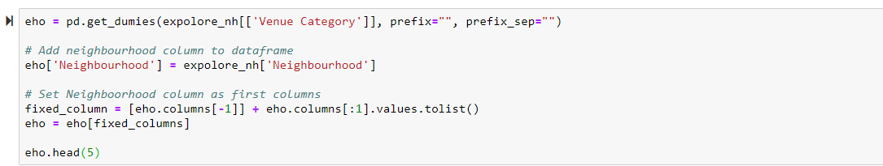
Method
Feautore extraction
One Hot Encoding (EHO)

Slide 6
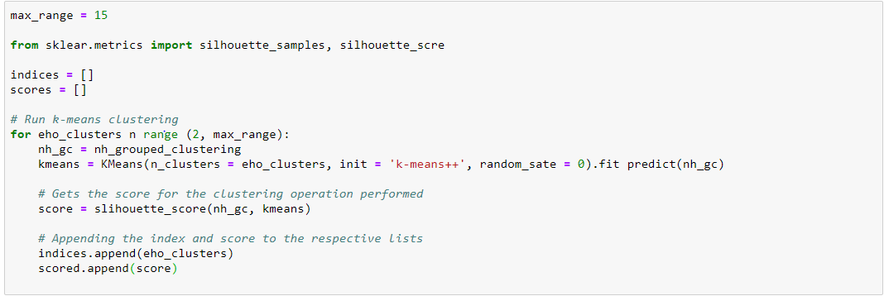
Unsupervised learing
K-Means Clustering

Slide 7
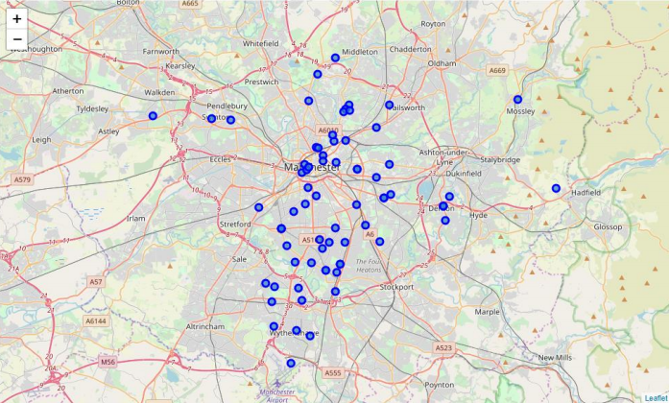
Plotting
-Folium

Slide 8
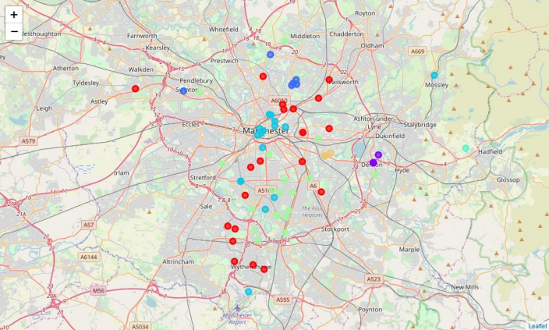
Results
Display of clusters
After displaying the clusters, individual clusters were studied and cluster 4 had the most restaurants

Slide 9
Discussion
Cluster number 4 best neighbourhood to start an restaurant
K-Means model worked accurately and positively clustered similar neighbourhoods togerter.
After checking all four clusters. The client should chose for neighbourhoods such as Barlow Moor, Brookelands and Hyde Newton(Ward) that are part of cluster 4 and are good neighbourhoods to start a restaurant
The client can make a decision based on those outcomes. However other factors such as availability and legal requirement should be taken into consideration as those are out of scope for this project

Slide 10
Conclusion
Different machine learning techniques and analyses of the data used in this project is very helpful for an business to make a decision.
Libraries such as BeautifullSoup, GeoPy and Folium make it easy to analyse geographical locations.
This project niehgbourhoods of Manchester city were studied and resulted in the best neighbourhoods for the client to open up a restaurant

